Slide 1

INTRODUCTION TO
NEURAL
OSCILLATION
ANALYSIS
Cantin Ortiz, Letizia Signorelli
OBiWoW 2025 — 12/12/2025

Slide 2
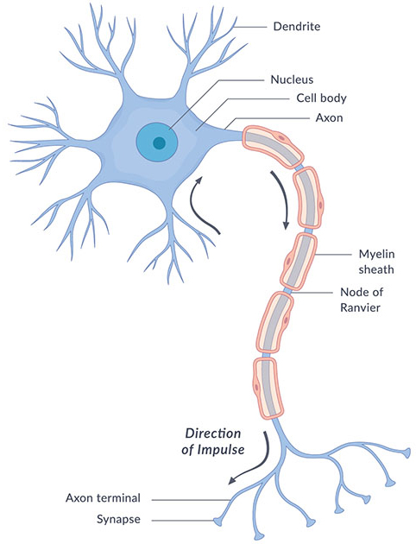
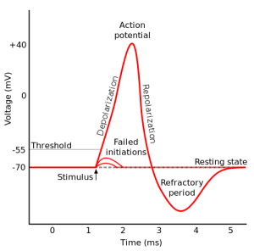
IN THE BRAIN, INFORMATION IS PROCESSED BY NEURONS THROUGH ELECTRICAL SIGNALS
Neurons: dedicated cell type to process information
10¹¹ in the human brain, 10⁷ — 10⁸ in rodents
Highly interconnected (1000s synapses per neuron)
Mostly communicate via action potentials: non-linear responses
NICHD, NIH
What are the parts of the nervous system?
Cantin Ortiz, Letizia Signorelli — OBiWoW 2025

Slide 3
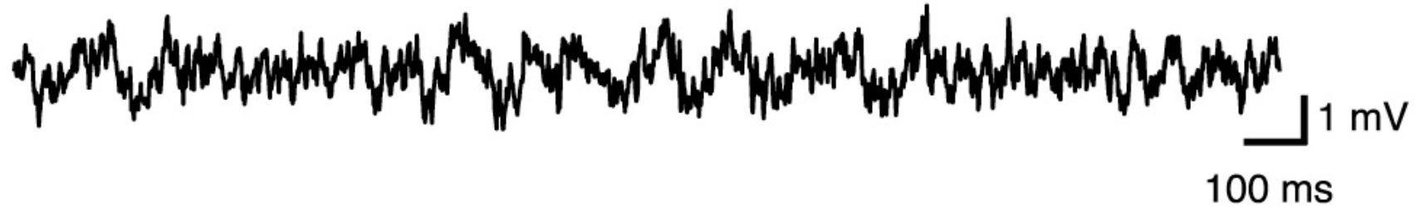
3
NEURAL OSCILLATIONS EMERGE FROM SYNCHRONOUS MEMBRANE POTENTIAL FLUCTUATIONS
Current superimpose forming 'electric field'
Neural oscillation: rhythmic, repetitive electrical activity generated by synchronous membrane potential fluctuations of a population of neurons
Mostly reflect synaptic activity: inputs
Characterised by their amplitude (“strength”) and frequency
Cantin Ortiz, Letizia Signorelli — OBiWoW 2025
Kim et al., Cell, 2016

Slide 4
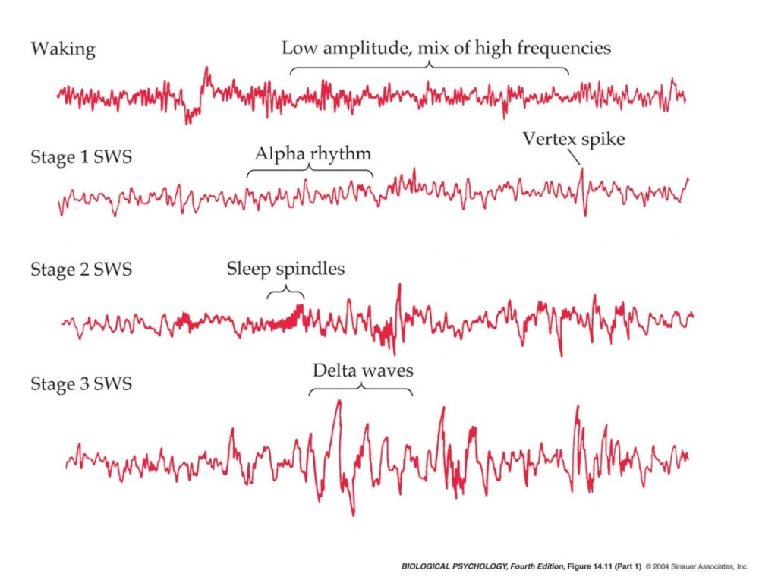
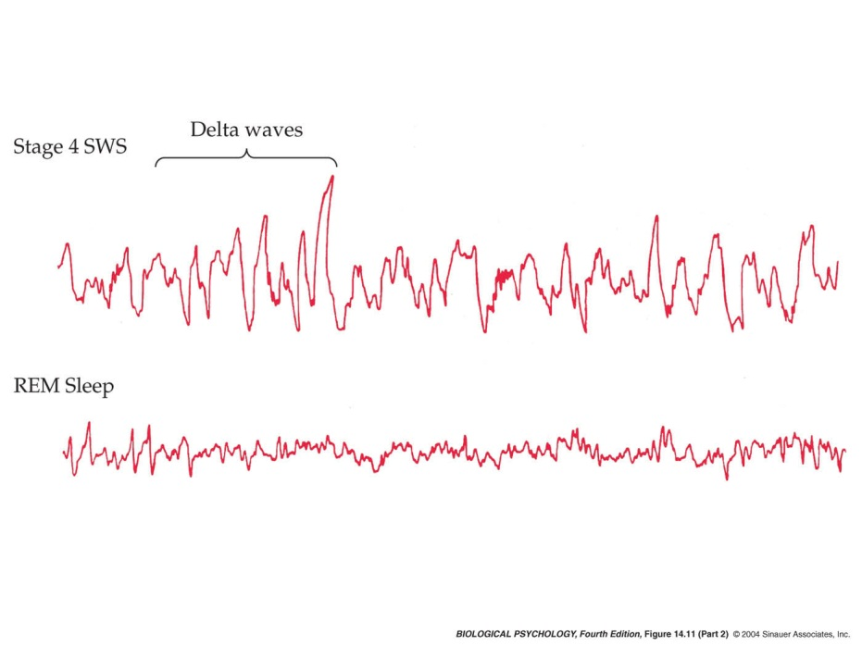
4
EXAMPLE: IDENTIFYING DIFFERENT SLEEP STATES BASED ON NEURAL OSCILLATIONS
NREM Sleep
Cantin Ortiz, Letizia Signorelli — OBiWoW 2025
Bear 4th edition 2002

Slide 5
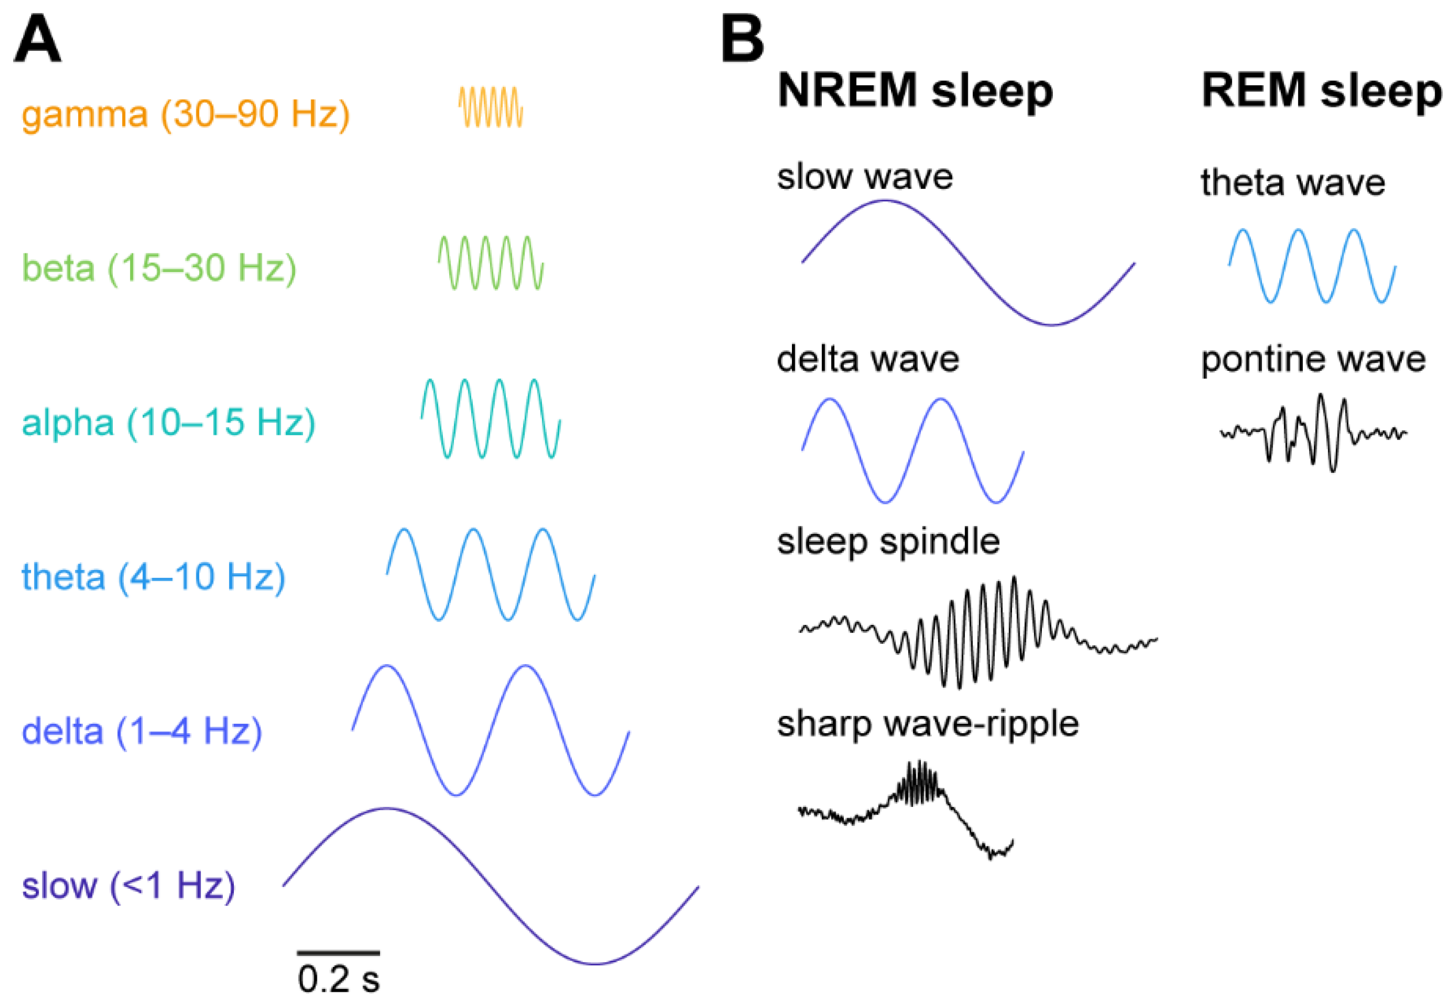
5
DIFFERENT TYPES OF OSCILLATIONS
We can analyse neural oscillations by their frequency bands and link them to brain states
Some oscillations are composite (envelop, unit activity) and require finer methods of detection
Attention, cognition, memory
Alertness, thinking
Resting, closed-eyes
Locomotion, REM
Deep sleep
Cantin Ortiz, Letizia Signorelli — OBiWoW 2025
Bear et al, Neuroscience Exploring the brain 4th edition, Britton 2016

Slide 6
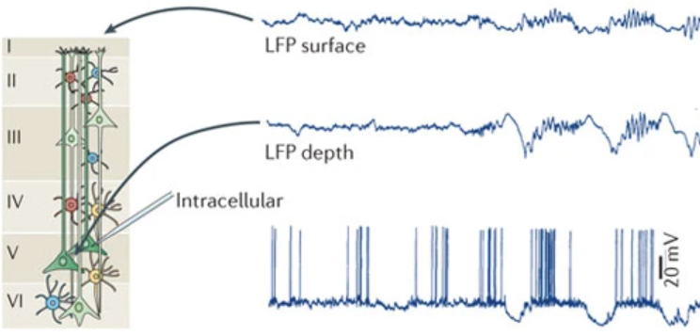
DIFFERENCES BETWEEN OSCILLATIONS (LFP) AND ACTION POTENTIALS
6
Local Field Potential (LFP)
Oscillations 0.1 – 200 Hz – acquisition > 1500 Hz
Mostly reflect synaptic inputs
Summation of activity within a small region (ca ⌀ 300µ)
2. Action potential
1-2 ms (500-1000 Hz) – acquisition > 20 000 Hz
Neuronal output
Local activity (ca ⌀ 100µ) – multi or single units
Buzsáki, György, Costas A. Anastassiou, and Christof Koch.
"The origin of extracellular fields and currents—EEG, ECoG, LFP and spikes."
Nature reviews neuroscience 13.6 (2012): 407-420.
Cantin Ortiz, Letizia Signorelli — OBiWoW 2025
Notes:
Theta: 6-10 in rats

Slide 7
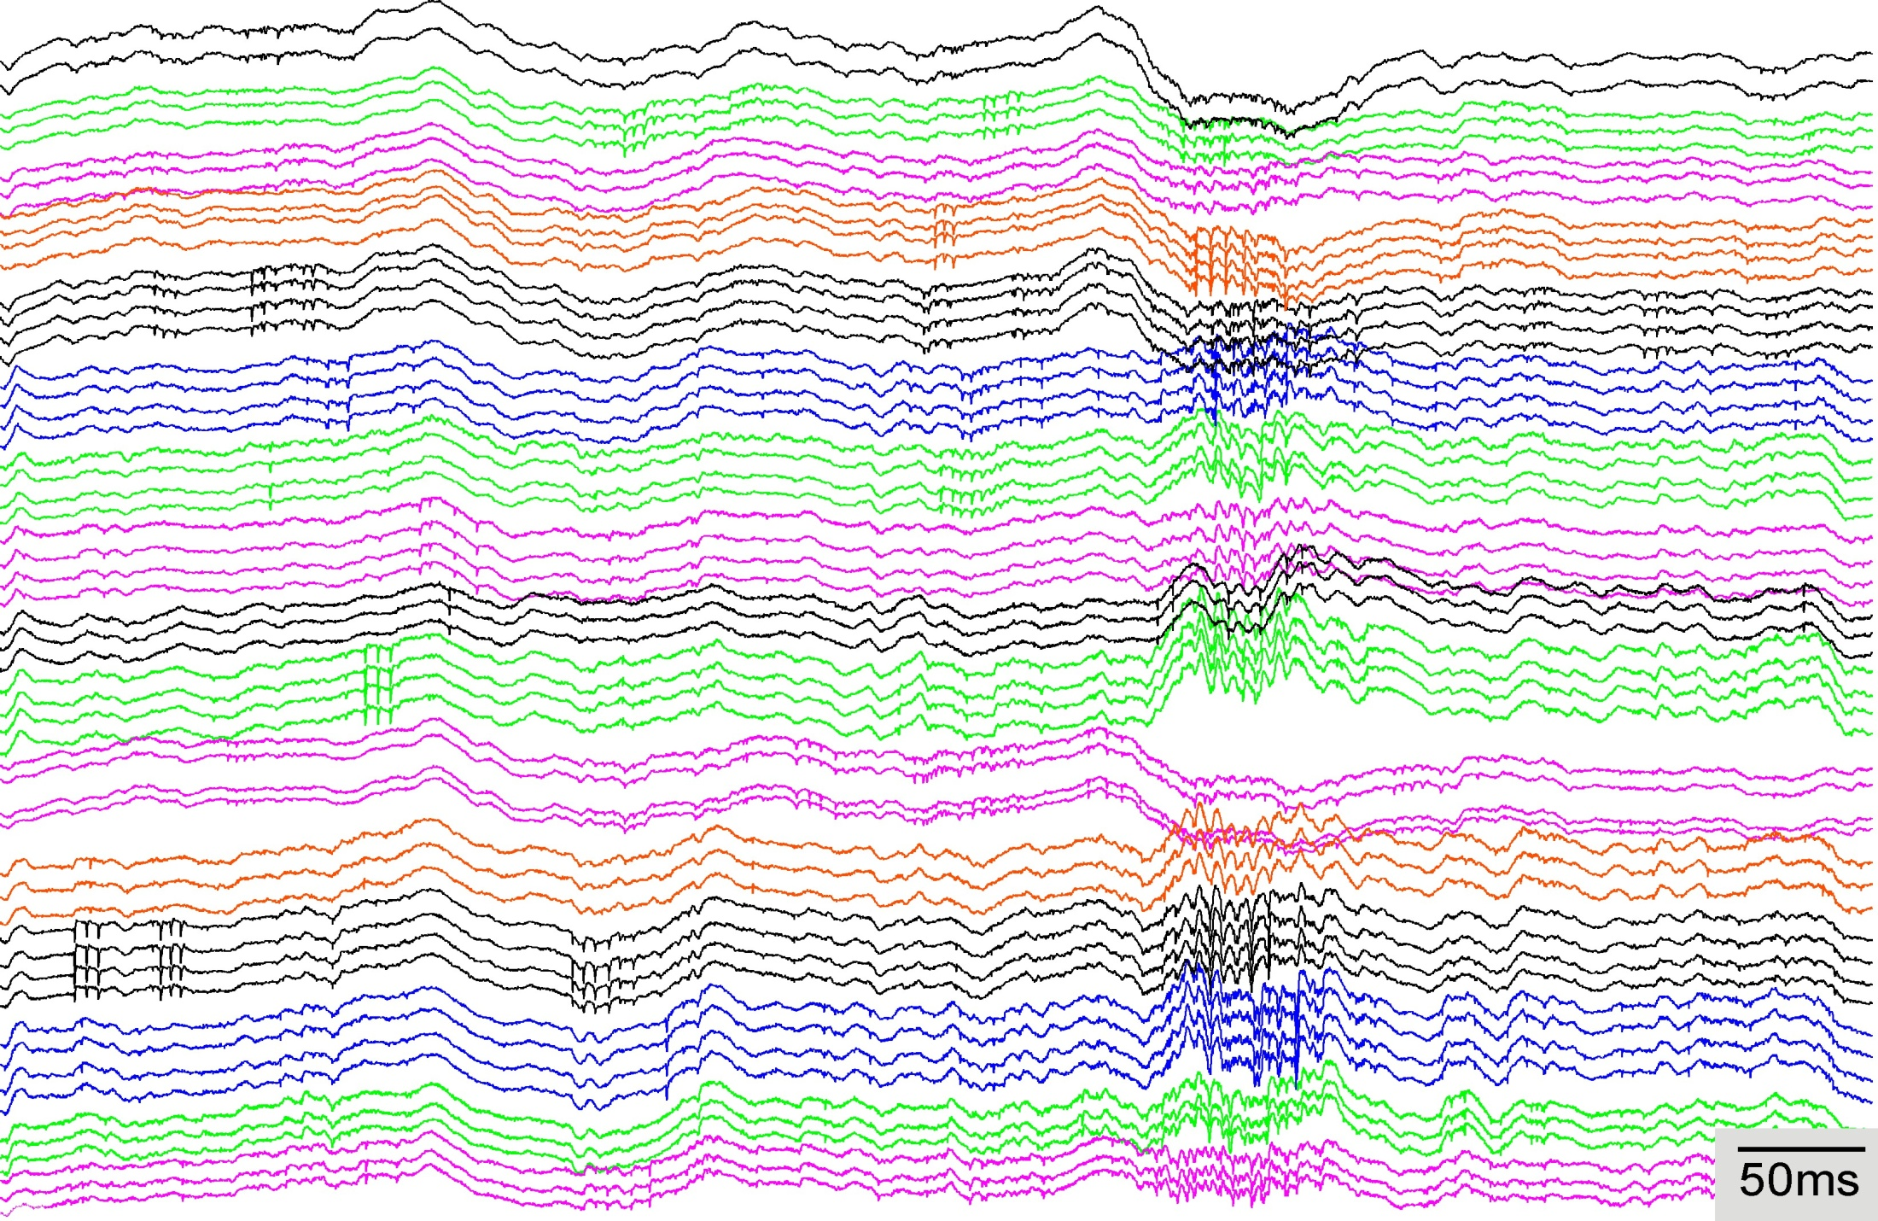
7
EXAMPLE RECORDING WITH BOTH ACTION POTENTIAL AND OSCILLATIONS
16 tetrodes (adult HPC)
From Charlotte Boccara
Single neuron activity (action potential)
Global general neural events (“EEG like”)
Cantin Ortiz, Letizia Signorelli — OBiWoW 2025

Slide 8
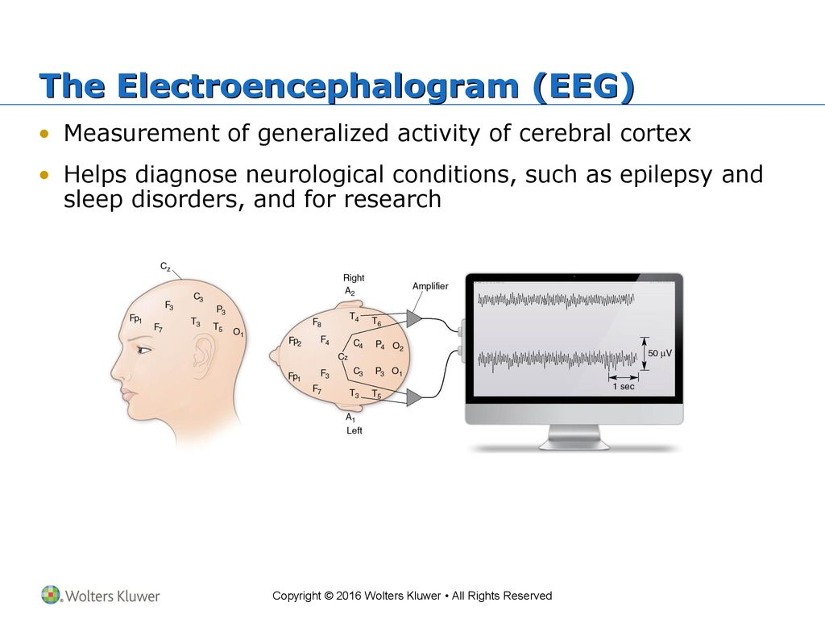
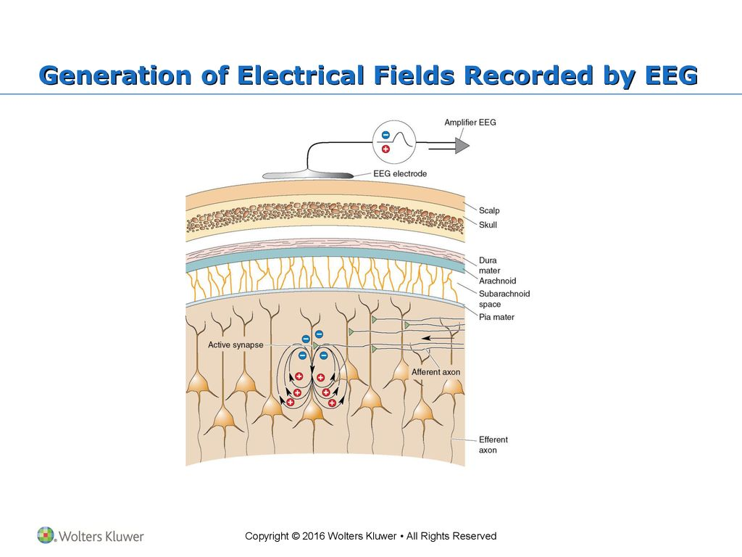

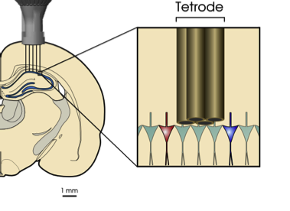
8
HOW TO RECORD OSCILLATIONS?
EEG: Electroencephalography
ECoG: Electrocorticography
Bear et al, Neuroscience Exploring the brain 4th edition, Britton 2016
Local Field Potential (LFP) with intracerebellar electrodes
Cantin Ortiz, Letizia Signorelli — OBiWoW 2025

Slide 9
WORKSHOP PLAN
9
9H00 - 9H50: INTRODUCTION AND BASIC SIGNAL PROCESSING
Analog vs digital signal
Filtering
Downsampling
BREAK 1: 9H50 — 10H00
10H00 — 10H50: TIME-FREQUENCY ANALYSIS
Fast Fourier Transform
Spectrograms
Important parameters
BREAK 2: 10H50 — 11H00
11H00 — 12H00: SLEEP SCORING AND CONCLUSION
EMG and EEG
Wake vs Sleep
Non-REM vs REM
Cantin Ortiz, Letizia Signorelli — OBiWoW 2025

